Slide 1
Learning Java 8
Method Referencing

Slide 2
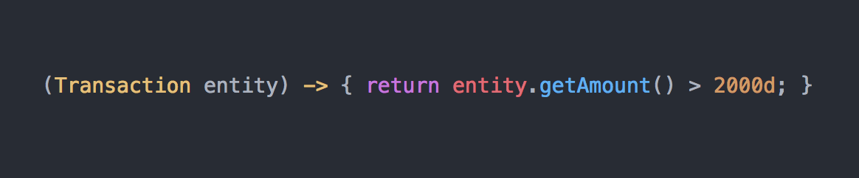
Lambda Syntax
Method Parameters
Method Body
Arrow
In simple words : Lambda is a function with parameters and body, but without a name

Slide 3

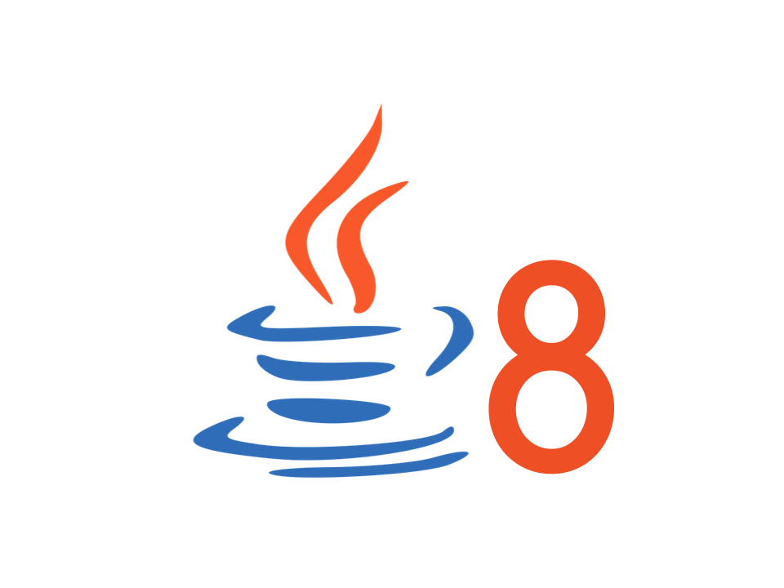






Slide 4
Recipe #1
(args) -> ClassName.staticMethod(args)
ClassName::staticMethod
Example :
Lambda : s -> String.valueOf(s)
Method Reference : String::valueOf

Slide 5
Recipe #2
(arg0, rest) -> arg0.instanceMethod(rest)
arg0 is of type ClassName
ClassName::instanceMethod
Example :
Lambda : (s1, s2) -> s1.compareToIgnoreCase(s2);
Method Reference : String::compareToIgnoreCase

Slide 6
Recipe #3
(args) -> object.instanceMethod(args)
object::instanceMethod
Example :
Lambda : (s) -> “Match”.startsWith(s);
Method Reference : “Match”::startsWith

Slide 7
Quiz..
Answer:
Answer:

Slide 8
Constructor Reference
Given a supplier definition as below
We can use Constructor Reference to replace the lambda
If Constructor is parameterized, then a possible way to using Constructor Reference

Slide 9

Time to Exercise

